Slide 1

VS World Everything You Need
A Best Website
For
Online
Online job portal

Slide 2

Introduction
PHP
CSS
A Perfect Webpage
HTML
JAVA Script

Slide 3
Index
PHP
HTML
CSS
JAVA Script
PHOTOSHOP

Slide 4
PHOTOSHOP
Best App For Editing
Photoshop files have default file extension as .PSD, which stands for "Photoshop Document." A PSD file stores an image with support for most imaging options available in Photoshop. These include layers with masks , transparency, text, alpha channels and spot colors, clipping paths, and duotone settings. This is in contrast to many other file formats (e.g., .JPG or .GIF) that restrict content to provide streamlined, predictable functionality

Slide 5

HTML
“Hypertext Markup Language.”
It is a standardized system for tagging text files to achieve font, color, graphic, and hyperlink effects on World Wide Web pages

Slide 6
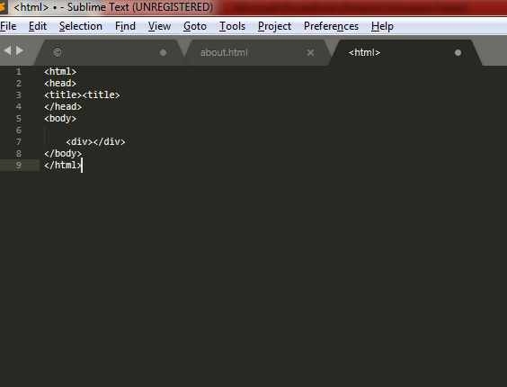

Slide 7
,
TAGS:
Single ended:
<br>,<link>
Etc.
Double ended:
<html> </html>
<div> </div>
etc.
,

Slide 8

CSS
CSS describes how HTML elements are to be displayed on screen, paper, or in other media
CSS stands for Cascading Style Sheets

Slide 9

JAVA Script
JavaScript can update and change both HTML and CSS. JavaScript can calculate, manipulate
and validate data
JavaScript is the Programming Language for the Web.

Slide 10


PHP:--
PHP-” Personal Home Page Hypertext Preprocessor Language”
PHP is a server side scripting language that is embedded in HTML. It is used to manage dynamic content, databases, session tracking.

Slide 11
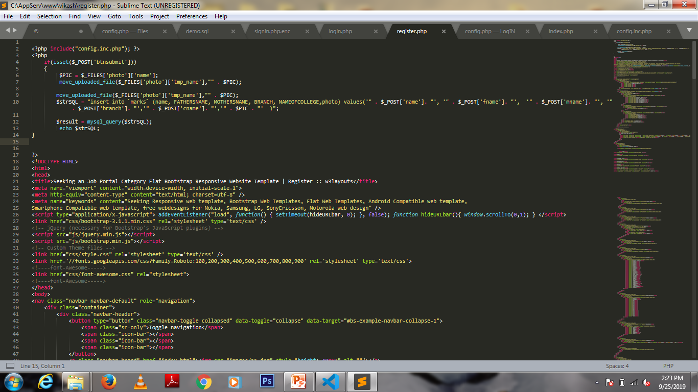
.

Slide 12
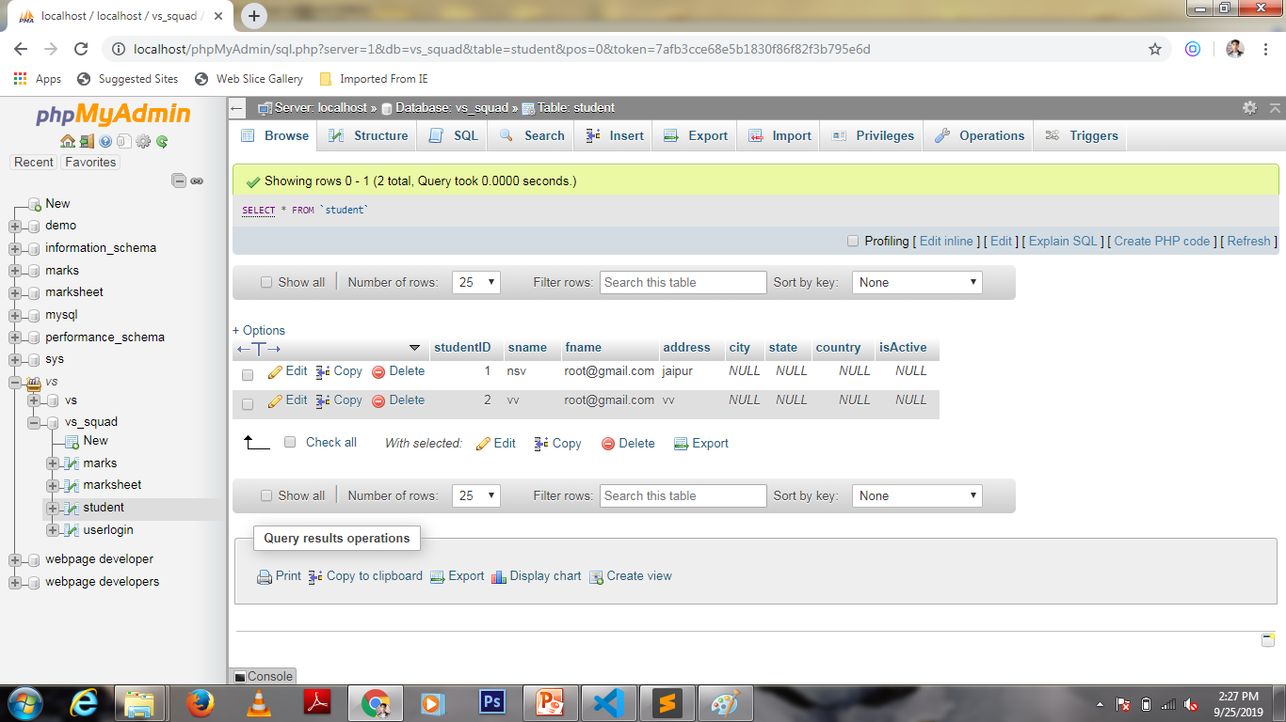

Slide 13

Additional Pages for Site:-
Static Pages
Dynamic Pages
About us.
Terms and conditions.
Contact us.
FAQ & Help.
Feedback.
Careers.
Features.
Home Page.
Category Page.
Product Page.
Search & Search Results.
Login/Create Account.
Cart Page.
Guest Checkout.
My Order.
Returns .
Cancellation.
Payment terms and Payment Confirmation.

Slide 14
Static Pages
About us.(Company Details)
Terms and conditions.
JOBS BY CATOGRIES
NAVIGATE
TESTIMONIALS
CONTACT US
Pages contain a predefined
Data
and Style.
And this data can’t be changed
Without code.

Slide 15
Dynamic Pages:-
Home Page:-
Welcome Data.
Daily Jobs .
Menus.
Jobs by location.
And so on.

Slide 16
Log IN/Register Page:-
Logging IN a user.
Registering A New user to your site.
Premium access to site

Slide 17
Servers & Database
Database
Servers
Database for
Users Registration
User resume
Users interest
Users details.
A Offline Server “Localhost”.

Slide 18
Thank You !

